Slide 1
Data Science Basics in R:
Day 4: R in the “Real World”

Slide 2
Goals for today
Get familiar version control and github
Create a github account
Learn how other people use R in their day jobs
Brainstorm how you can keep using R
Great creative and have fun exploring datasets

Slide 3
Version control with github

Slide 4
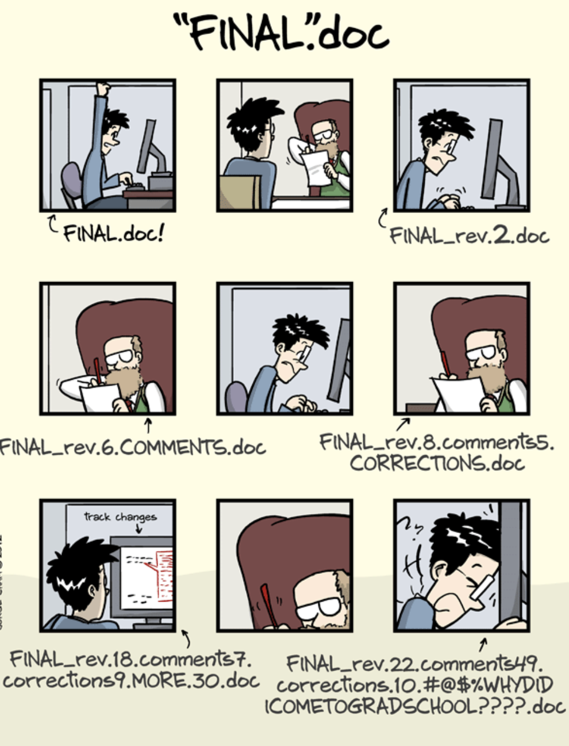
PHD comics

Slide 5
https://www.youtube.com/watch?v=BCQHnlnPusY&list=PLRqwX-V7Uu6ZF9C0YMKuns9sLDzK6zoiV

Slide 6
Make a github account

Slide 7
Research and open-source projects in R

Slide 8
Where to learn more

Slide 9
How to get good at R
(or python, or SQL, github, or…)
Use R, and use it often
Use R when you could use Excel, even if it takes longer
Consider a fun personal project
Follow others on github and check out what they’re doing

Slide 10
Thank you!
Please stay in touch.
Lecture and course material adapted from Intro to R materials created by Alex Douglas, available online here, with corresponding free online textbook.

